Slide 1
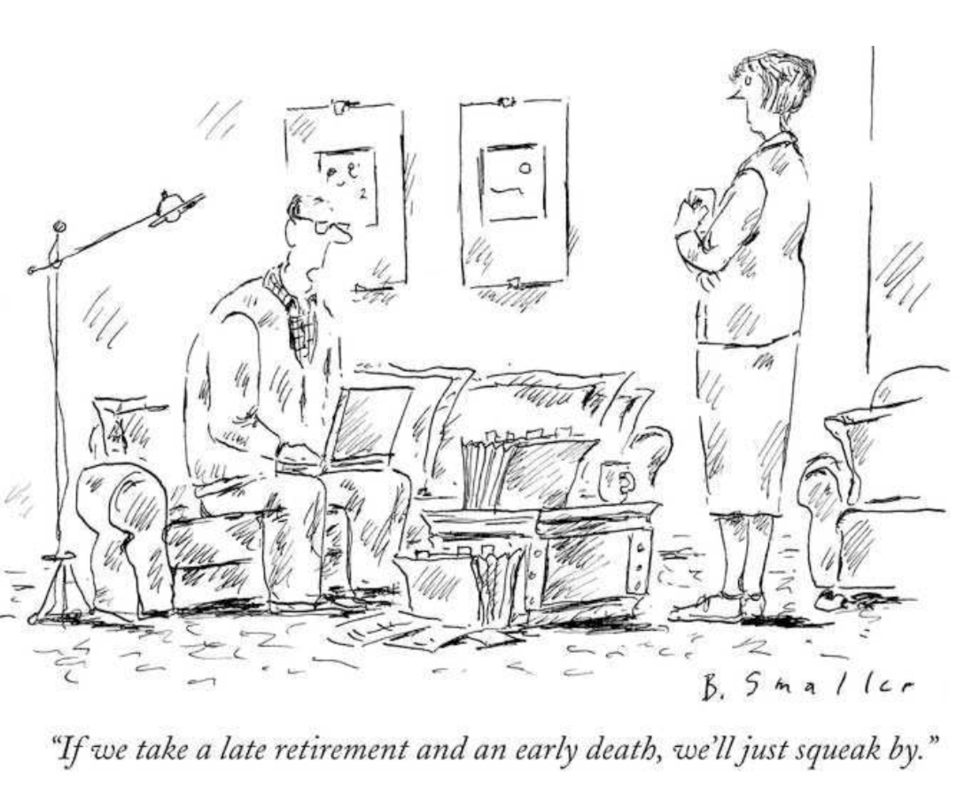
How To Invest In a 401(k)
Dan Ostrov, Santa Clara University
The above is how not to invest in a 401(k).

Slide 2
Outline
Why You Should Invest in a 401(k)
The Good, The Bad, and The Ugly About The Stock Market
Active vs. Passive Investment Strategies
How To Invest When You Start Working
Many of the charts and graphs here come from the books “A Random Walk Down Wall Street” (2011 edition) and “The Random Walk Guide To Investing” (2003 edition) by Burton Malkiel. Both of these books, especially the latter, are really easy to understand and contain a wealth of well-presented information.
An even more basic version, “Investing Made Simple" by Mike Piper, explains the market quite well in 100 small pages with big type.

Slide 3
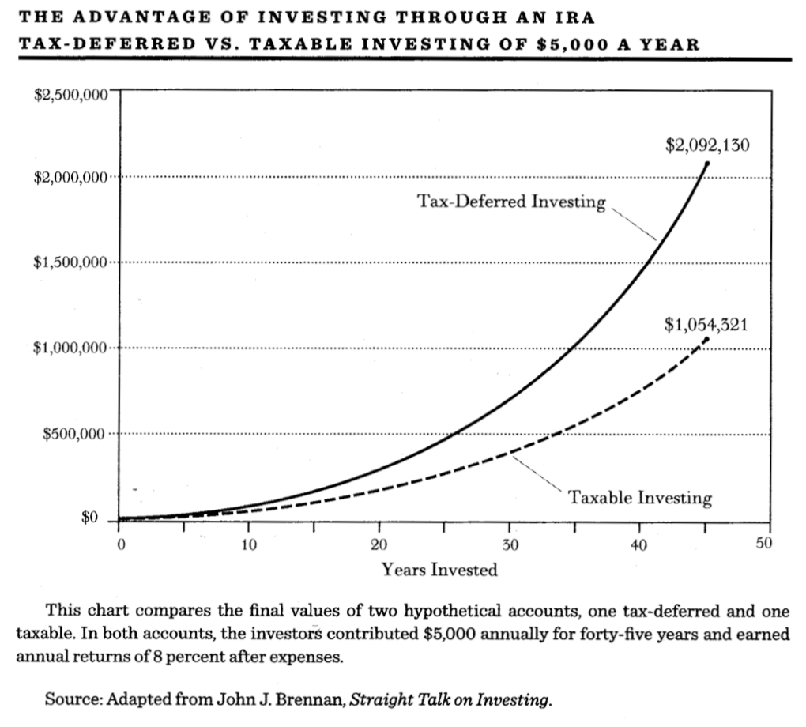
Why Invest in a 401(k)?
Two employees invest $5000 per year, growing at 8% per year.
One invests in a 401(k) through their workplace.
The other invests in a normal taxable account outside their workplace and triggers taxable gains every year, which are taxed at 28%.
What happens after 45 years?
The 401(k) is worth almost twice what the taxable account is worth!

Slide 4
When Should I Start Investing?
Again, consider two employees with accounts that grow at 8% per year.
Employee A puts X dollars away every year for 10 years, then stops investing due to deciding to reallocate their income to a cocaine habit.
Employee B puts away nothing for 10 years, but then starts putting X dollars away every year after that.
Question: When does Employee B catch up to cokehead Employee A?
Answer: NEVER. Employee B never catches up!
In fact, the difference between the two gets larger, not smaller, over time.
Why? Because the 8% from employee A’s account is always bigger than X.
MORAL: It is pretty much insane not to save in a 401(k) as soon as you start a real job. The money you save for retirement in stocks and bonds within your first 10 years often matters more than everything you save after that.

Slide 5
Definitions
Stocks give you partial ownership of a company.
Bonds give you partial payback from loans to a company or to a government.
Stocks have better returns than bonds on average, but stocks’ returns also have more uncertainty (volatility) than bonds.
An asset class is just a category of stocks (or of bonds, etc.). For example, “large cap stocks” are stocks for large American companies, “intermediate government bonds” are U.S. government bonds that mature in 5-10 years.
An index is a group of stocks (or of bonds, etc.) chosen to represent an asset class. For example, the “S&P 500” is an index of 500 of the largest U.S. companies. This index is often used to represent large cap stocks.
A mutual fund is a professionally managed group of stocks (or of bonds, etc.) in an asset class. They may be active, where the mutual fund manager buys and sells within the asset class, or passive, where the manager does nothing but buy and hold an index. 401(k)s usually only contain mutual fund options.

Slide 6
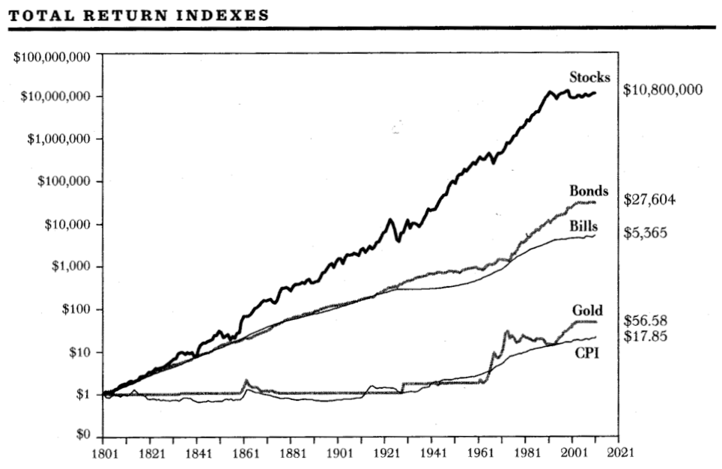
2. Stocks: The Good, The Bad, The Ugly
The Good: Average Annual Returns. Cash is 3.5%, Bonds are 5%, Stocks are 10%.
If you invest $10,000 at age 25, by age 65, on average, you would have:
Cash: $40,552
Bonds: $73,891
Stocks: $545,981
On average, stocks crush bonds and cash!

Slide 7
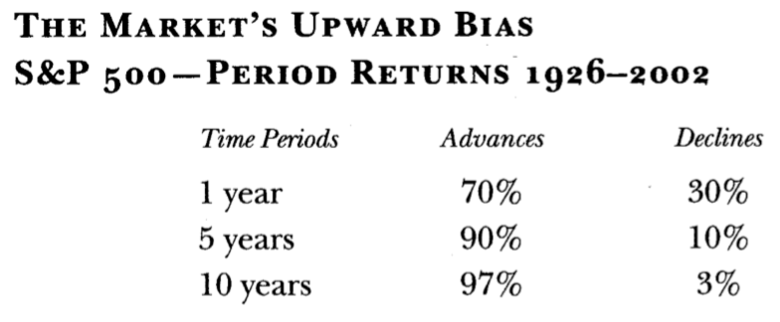
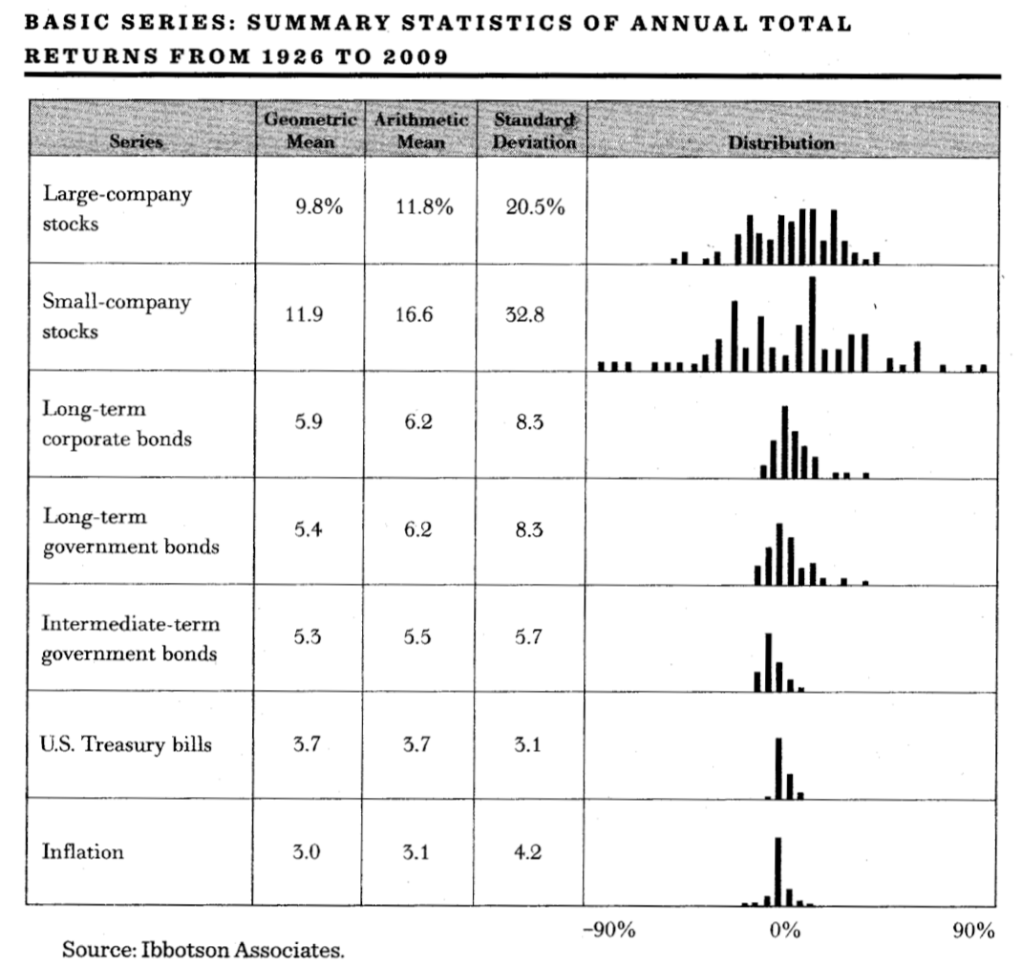
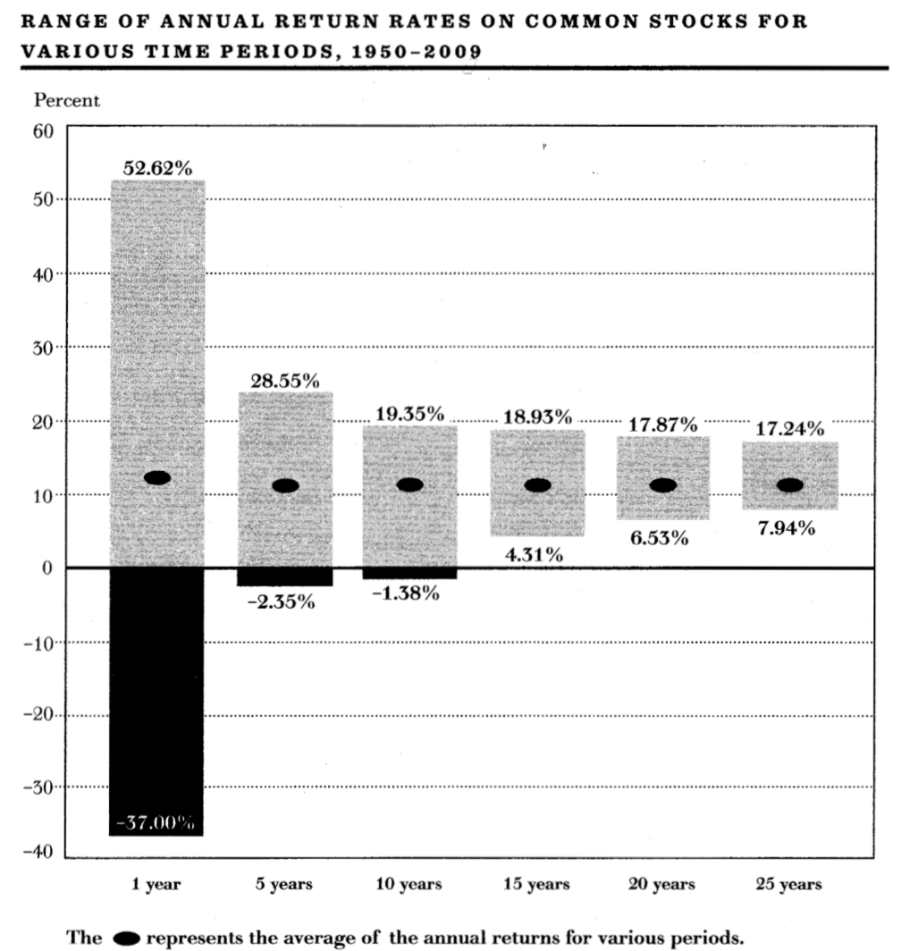
The Bad: Volatility
MORAL: Do not use stocks for short term investing (less than 5 years), but do for long term investing!

Slide 8
The Ugly: Stock Market Crashes!
Years | Percent Decline
1929-32 | 89%
1937-42 | 52%
1973-74 | 48%
2000-02 | 45%
2007-09 | 53%
Years | Percent Decline | Months of decline | Months to recover 75% of losses | Months to recover 100% of losses
1957 | 20 | 3 | 11 | 12
1961-62 | 29 | 6 | 10 | 14
1966 | 22 | 9 | 5 | 6
1968-70 | 37 | 18 | 9 | 22
1973-74 | 48 | 21 | 20 | 64
1981-82 | 22 | 13 | 2 | 3
1987 | 34 | 2 | 18 | 24
1990 | 20 | 3 | 5 | 5
2000-02 | 45 | 31 | 27 | 48
2007-09 | 53 | 18 | 24 | 47

Slide 9
3. Active vs. Passive Investment Strategies
Definitions:
Active Investing: You or someone you hire (like a mutual fund manager or financial advisor) actively trade your stocks and bonds in the hopes of getting better returns.
Passive Investing (also called “buy and hold”): You buy an index of stock (e.g., the S&P 500, which are the 500 largest U.S. companies) or of bonds, and then sit on your ass and do nothing. You sell only when you need the money.
Let’s explore active investment strategies...

Slide 10
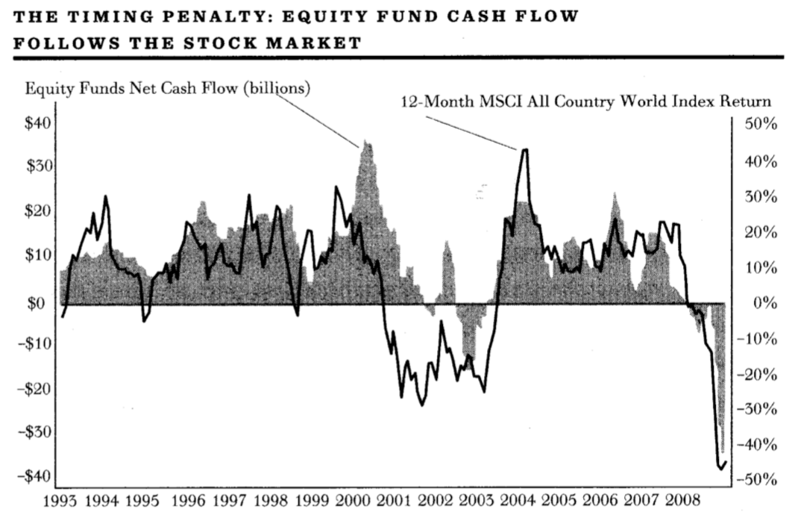
Active strategy: Buy low, sell high!
Sadly, the heavy majority of people buy high and sell low:

Slide 11
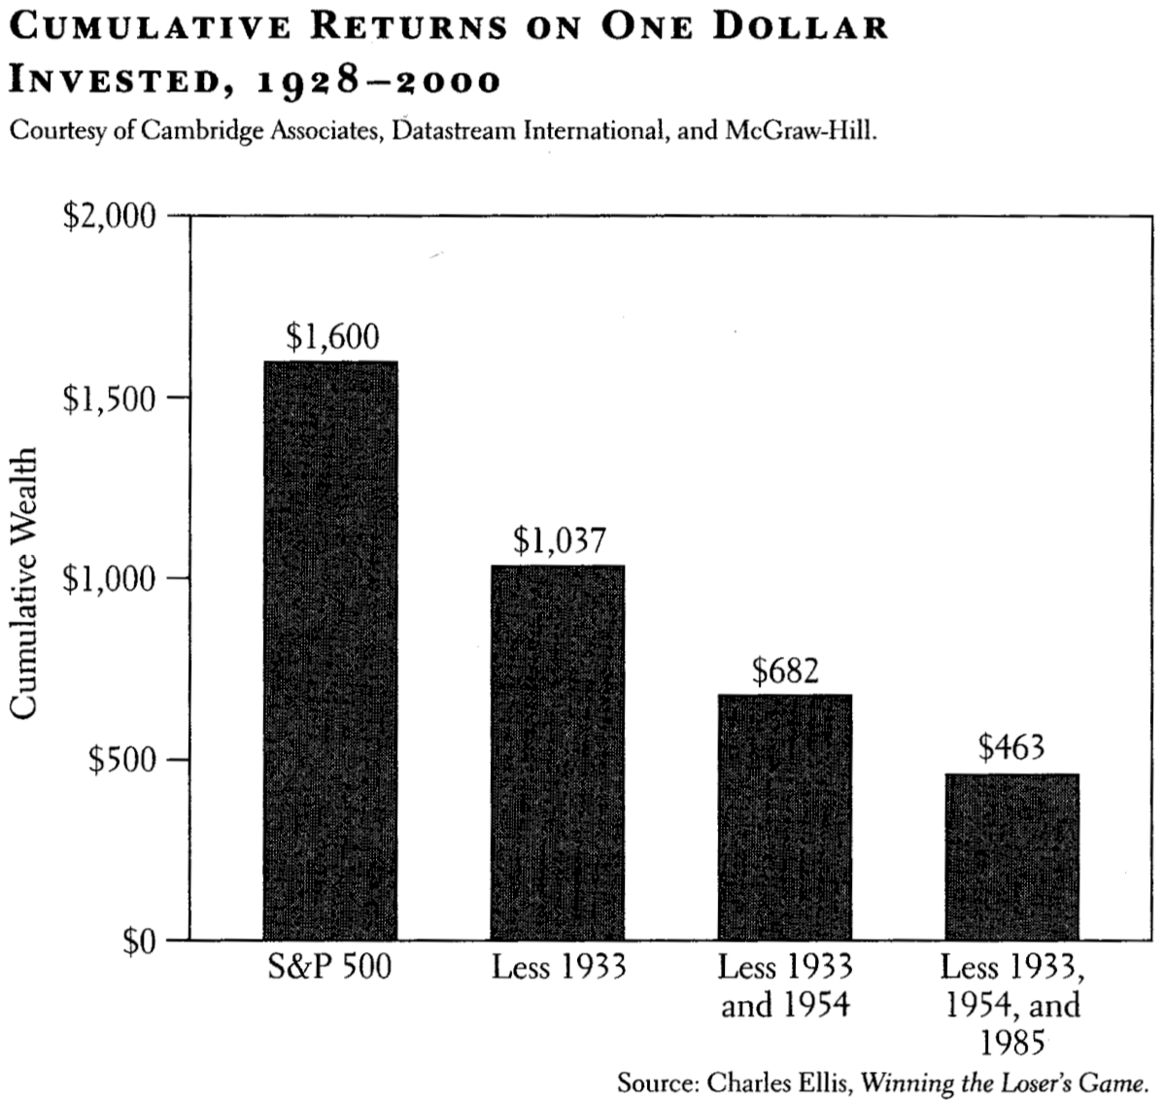
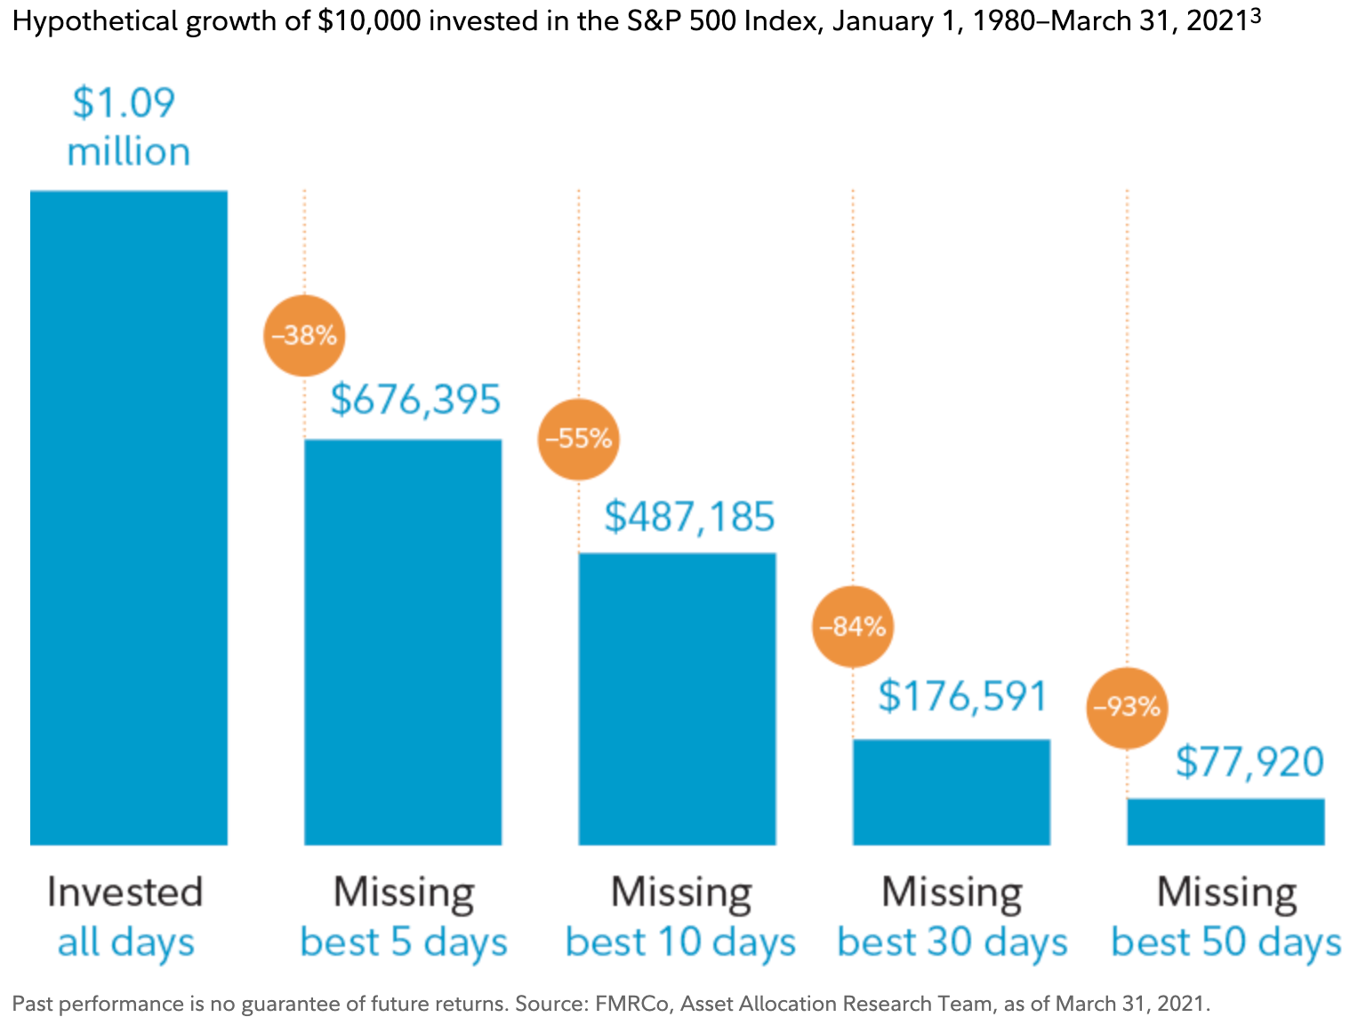
Ha, I managed to sell high!
Great, now when do you get back into the market to buy low? It really matters:
Cumulative returns on $10,000 invested in the S&P 500 Index from January 1, 1980 to March 31, 2021:
Cumulative returns on $1 invested in the market from 1928 to 2000:

Slide 12
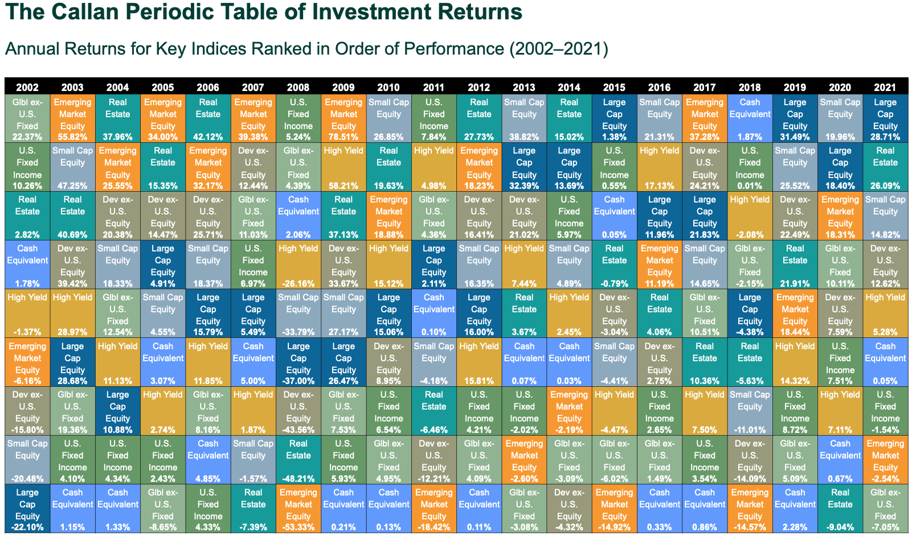
Active strategy: pick the best asset class

Slide 13
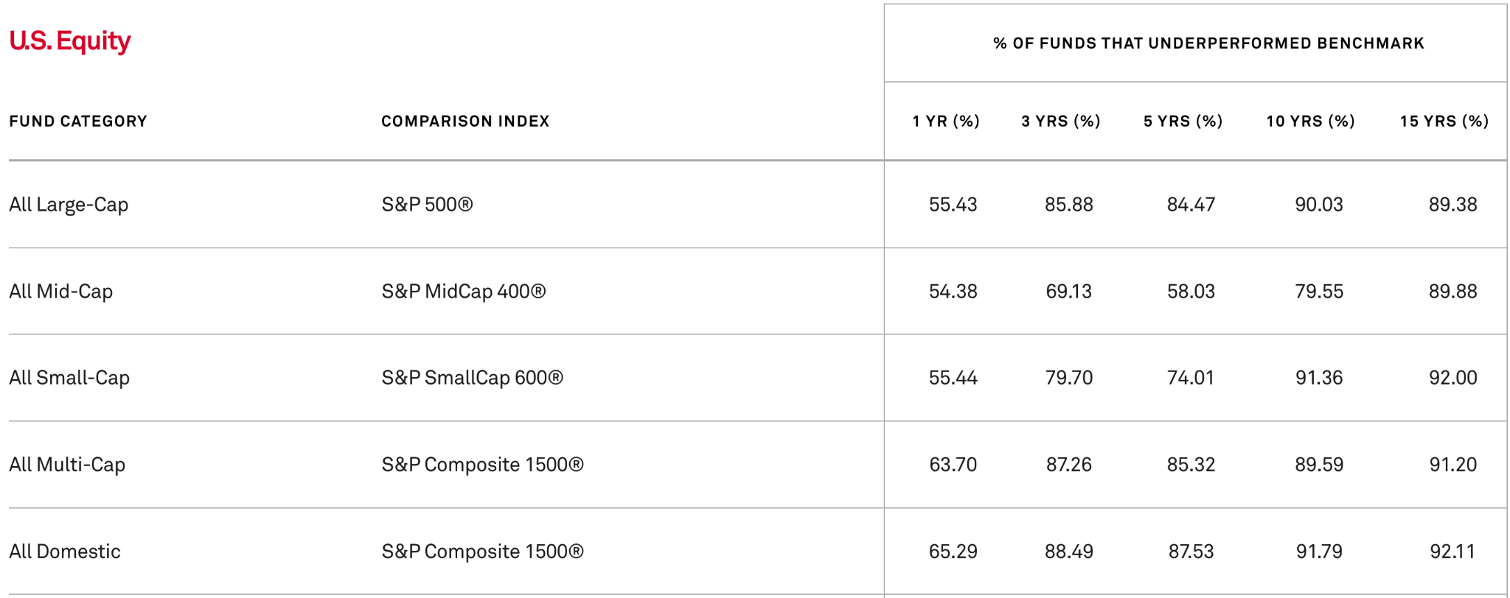
Active strategy: Mutual Fund Managers
Buy active mutual funds, because mutual fund managers are experts at stock trading - that’s why they have their jobs! Why just look at the data!:
(Source: S&P Dow Jones Indices as of June 30, 2022)
Wait. That’s awful! (And it’s equally bad for international stocks.)

Slide 14
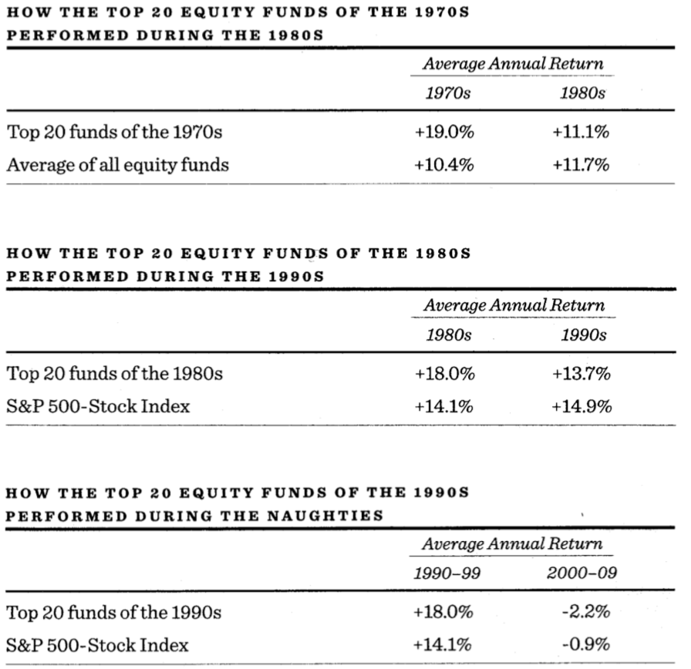
Choose the best mutual fund managers
The SEC disclaimer “past performance is no guarantee of future results” is required for a reason.

Slide 15
Active strategy: Hire a financial advisor
They charge about 1% per year to invest for you and advise you.
That seems a small amount, but it’s not.
If you stay with your advisor for, say, 41 years, then you have (0.99)⁴¹=0.662 of what you would have had otherwise. The difference goes to your advisor.
That is, for every 2 dollars you now have, they have 1 dollar.
Damn!

Slide 16
Why does passive do better than active?
Expense ratios (annual charge):
Active mutual funds charge 0.40-1.25% per year.
Passive mutual funds charge 0.00-0.15% per year.
There are transaction costs whenever stocks are sold or bought.
Some money must be kept as cash to trade.
Only short term rewards for mutual fund managers.
Active management is even worse in taxable accounts because selling stock (as active managing demands) triggers early capital gains taxes that erode earnings even more.
MORAL: Passive investing is much better than active investing, even if it seems like it should be the other way around.

Slide 17
4. I Got a Good Job. Now What?
If your company provides a 401(k) match, max this out! This is free money. It’s like giving yourself a raise. This is your first financial priority.
If you have credit card debt, get a plan to pay it off very quickly. Then pay off your college loans. Pay off the debt with the highest interest rates first. Debt with an interest rate over 8% is particularly bad.
Divert what you can to your 401(k) plan before you see your first paycheck.
Use auto-enrollment and/or auto-escalation if your company has them.
How much should you be putting away for retirement?
At least 15% of your salary.
No kidding.

Slide 18
Which funds should I use?
Your company will provide a whole bunch of mutual fund options for your 401(k). Which should you use?
Only use passive funds. How do you know if its passive? The expense ratio of the fund (which must be provided to you by law) will be less than 0.15% per year.
An easy way to invest: use a passive “target date fund” like Vanguard’s if it’s available. You just put everything into it, and you’re good.
If that’s not available, you can likely mimic a target date fund by using the passive index funds that are likely available in your 401(k) and the charts on the next slide.

Slide 19
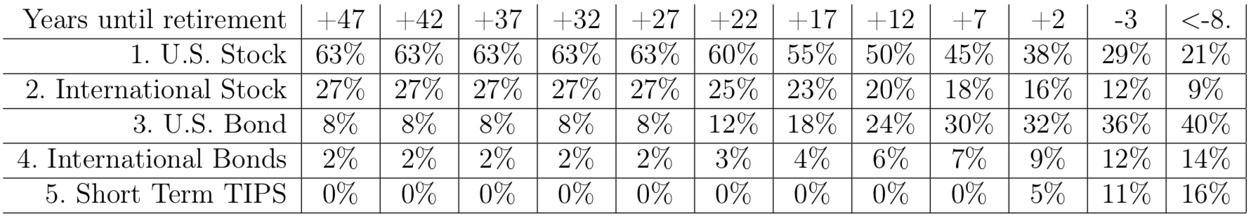
The Asset Classes in Target Date Funds
Target Date Funds are the financial industry’s best advice for which asset classes to have in your 401(k) as you age.
Here’s Vanguard’s suggestions:
Other companies use similar, but not identical, allocations.
The chart above just contains guidelines, so feel free to deviate from it.

Slide 20
Traditional 401(k) or Roth 401(k)?
If your company is cool, they will allow a Roth 401(k) option on top of your traditional 401(k). What’s the difference?
Traditional: No income tax is taken out from the part of your paycheck designated for your 401(k). But income tax is taken out when you remove money after you’re 59.5 years old. (Don’t remove it before then!)
Roth: Income tax is taken from the part of your paycheck designated for your Roth 401(k), but there’s no tax after that (as long as you don’t remove gains until you’re 59.5 years old).
IRAs (Individual Retirement Accounts) and 403(b) accounts work just like (traditional) 401(k)s. Roth IRAs and Roth 403(b) accounts work just like Roth 401(k)s. Note that you can open your own Roth IRA if your company doesn’t provide one.

Slide 21
So which is best? 401(k) or Roth 401(k)?
If your income tax rates were the same, there’s no difference between a traditional 401(k) and a Roth 401(k).
But income tax rates are progressive, meaning you pay higher taxes on higher income brackets, so you want to use the brackets with the lowest tax rates possible. To do that…
Try to put money in Roth 401(k)s early in your career when your tax bracket is lower.
Aim to have 30-70% of your eventual retirement money in a Roth 401(k) vs. a traditional 401(k), so you’ll have the ability to take out traditional 401(k) money at low tax brackets without being forced into high tax brackets.

Slide 22
Company Stock
If your company offers its company stock in your retirement plan, do not use it. If the company goes downhill, you’ll lose your job and, at the same time, your retirement will get nailed.
If your company offers stock outside your retirement plan at a discount (usually 15%) and you have extra money, you can buy it, but after holding that stock for two years, sell it and put the money into a good passive index fund. You need to wait two years to minimize taxes.

Slide 23
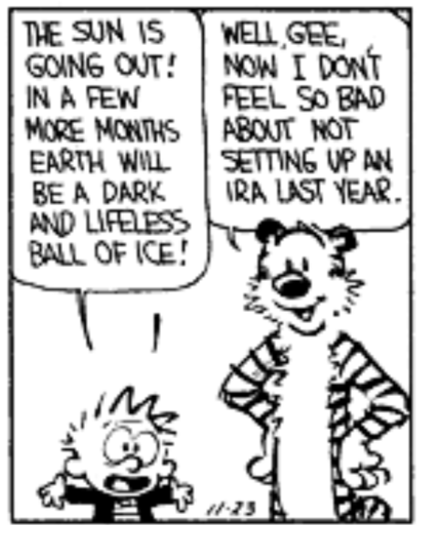
In conclusion, if you don’t plan for retirement early, your best hope for happiness is the destruction of Earth.
A case in point:

Slide 24
Questions...

Slide 25
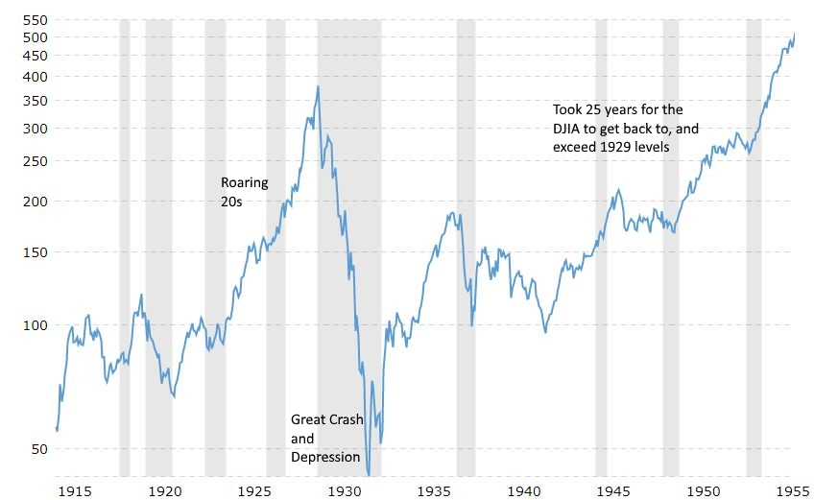
The Dow during the Great Depression

Slide 26
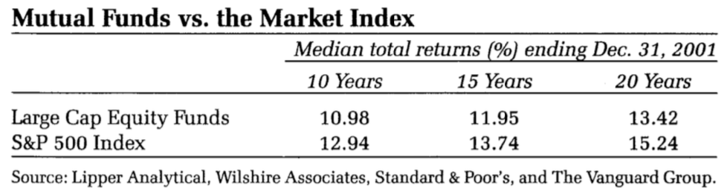
Active strategy: Mutual Fund Managers
Buy active mutual funds, because mutual fund managers are experts at stock trading - that’s why they have their jobs!
And look how well they do their jobs...
Okay, that kinda blows, but that’s just one asset class. What about the others?

Slide 27
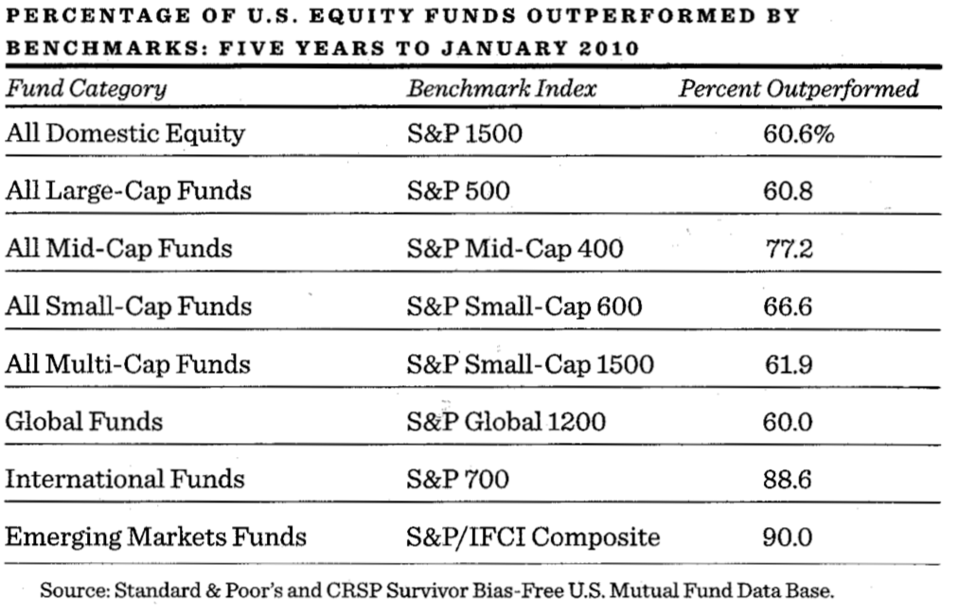
The others...

